Slide 1
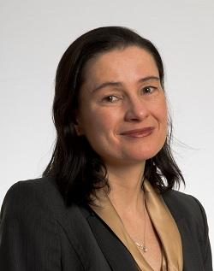





The Study of Quantitative and Formal Political Methodology for a Political Science PhD.

Slide 2
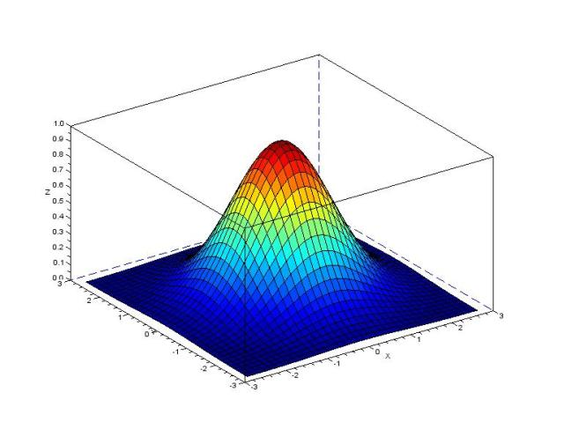
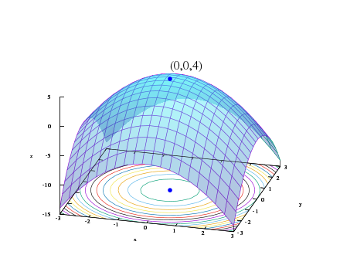
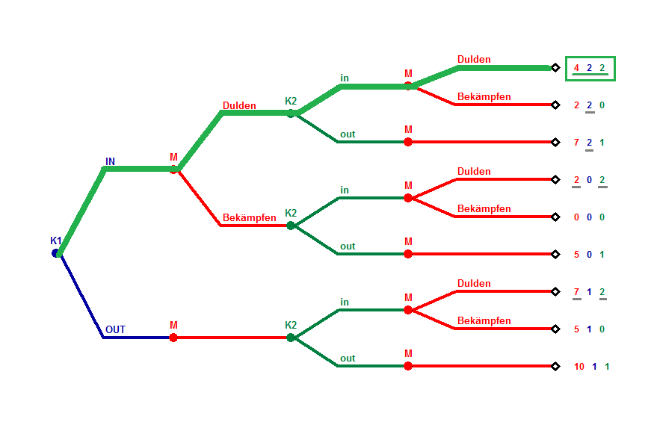
43401: MFPM
30901: GT I

Slide 3
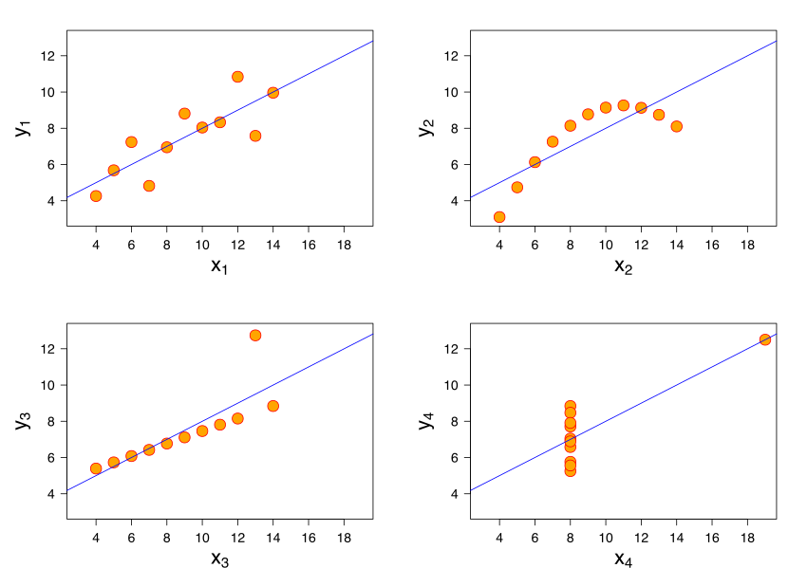
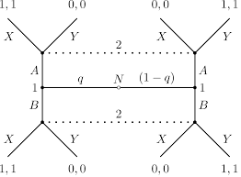
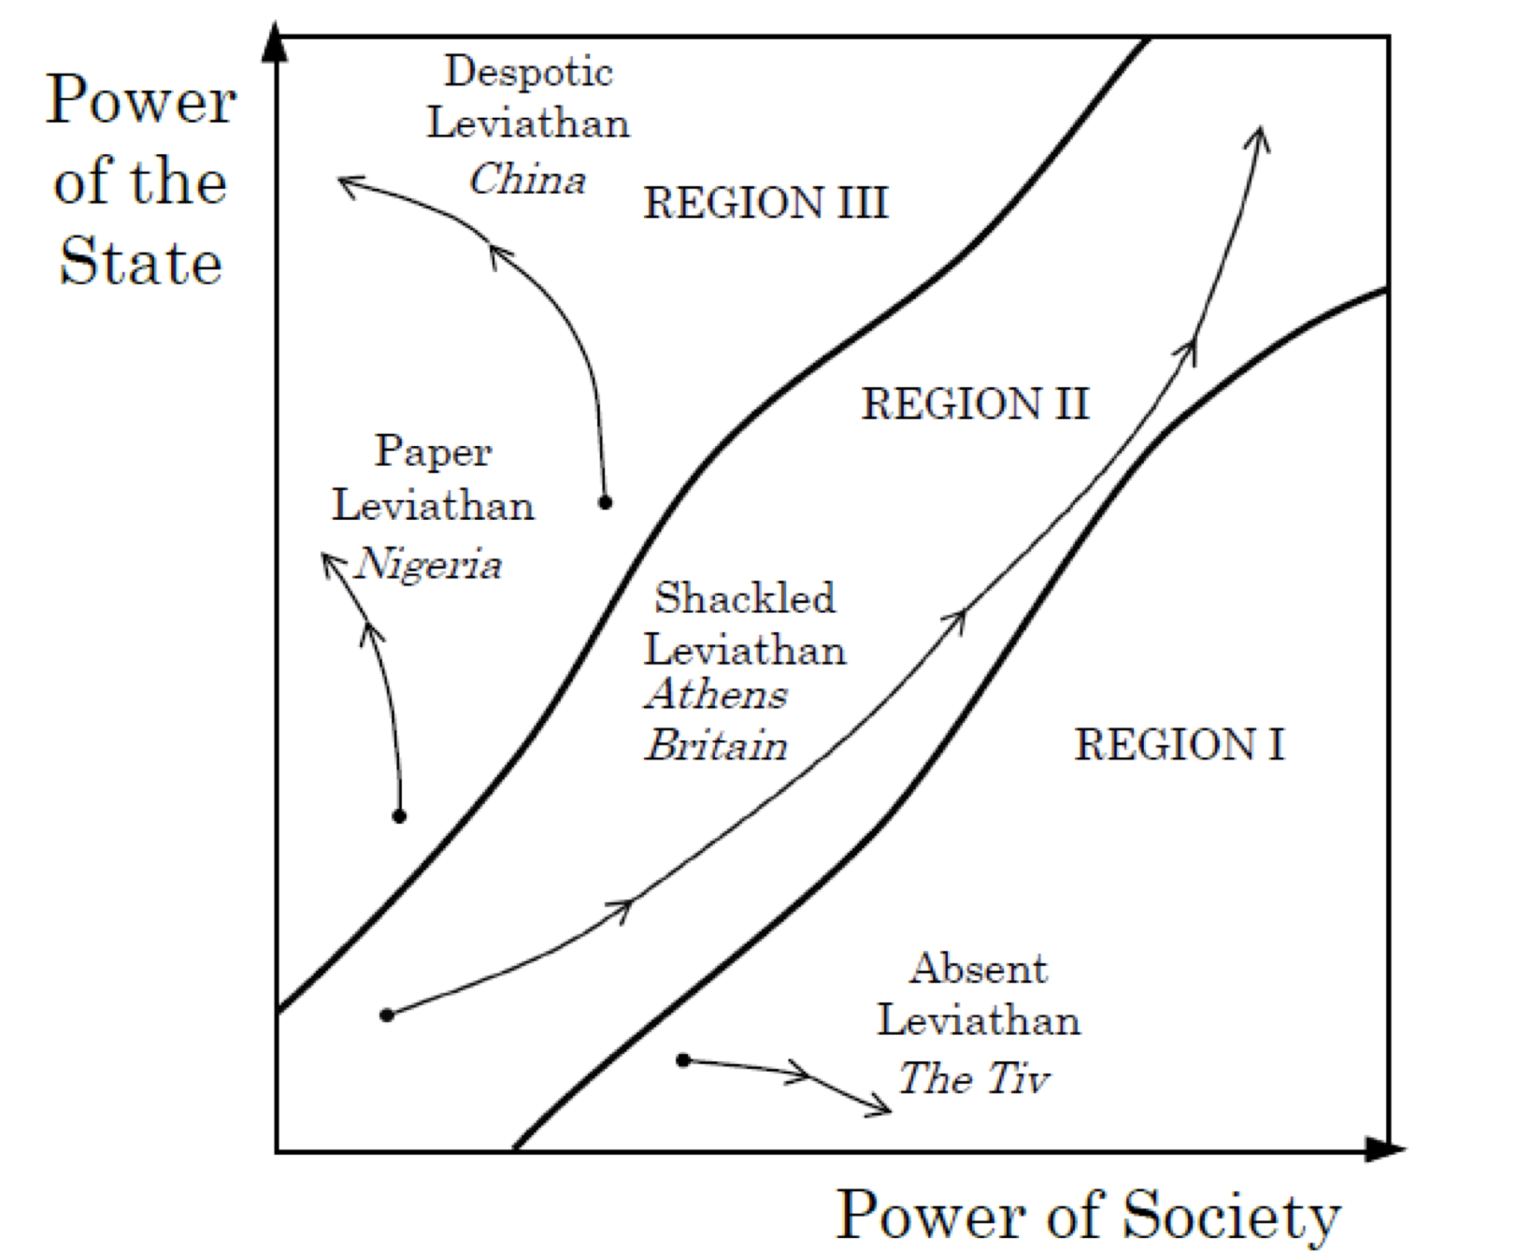
Year 1
30700: ILM
43401: MFPM
30901: GT I
31000: GT II
PPHA 40102:
FMDP

Slide 11
Year 1
30700: ILM
43401: MFPM
30901: GT I
31000: GT II
PPHA 40102:
FMDP

Slide 12
Year 1
30700: ILM
43401: MFPM
30901: GT I
31000: GT II
PPHA 40102:
FMDP

Slide 13
Year 1
30700: ILM
43401: MFPM
30901: GT I
31000: GT II
PPHA 40102:
FMDP

Slide 14


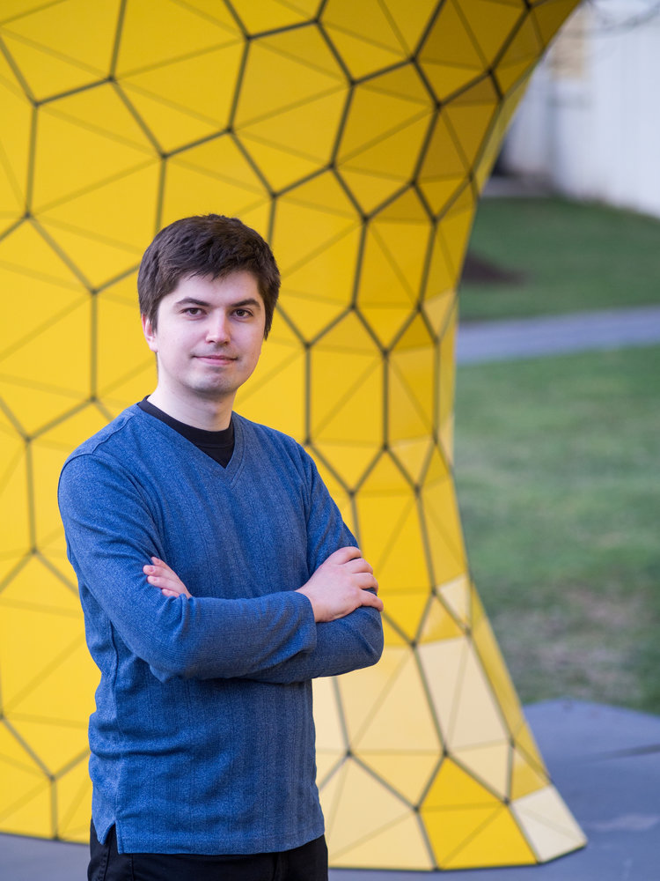

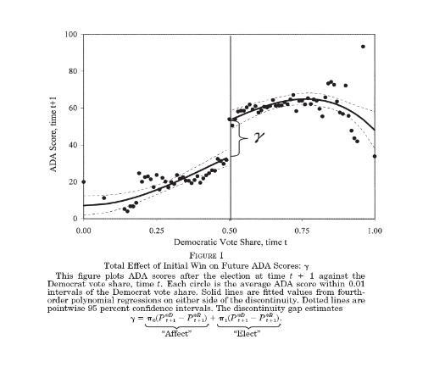
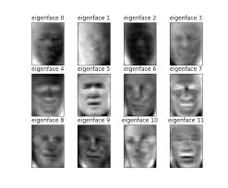
Year 1
Year 2+
30700: ILM
PPHA 41102: PE II*
x2 of:
43100: MLE
Causal inference II
Multilevel modeling
Experimental design
*CHMD
43401: MFPM

Slide 15
Year 1
Year 2+
30700: ILM
PPHA 41102: PE II
x2 of:
43100: MLE
Causal inference II
Multilevel modeling
Experimental design
43401: MFPM

Slide 16
Year 1+
43401: MFPM
30901: GT I
31000: GT II
One of
40815: NDFT
or
40801:
Social Choice
PPHA 40102:
FMDP

Slide 17
Year 1
Year 2+
30700: ILM
PPHA 41102: PE II
x2 of:
43100: MLE
Causal inference II
Multilevel modeling
Experimental design
43401: MFPM
30901: GT I
31000: GT II
One of
40815: NDFT
or
40801:
Social Choice
Shout Outs:
31101: Computational Tools for Social Science
57200: Network Analysis
IPE, Quantitative Security, PE, CPE, etc.
PPHA 40102:
FMDP

